Slide 1




NEW JERSEY
DEPARTMENT OF LABOR
AND WORKFORCE DEVELOPMENT
Welcome
  This Re-Employment Services and Eligibility Assessment
  Orientation is provided by the New Jersey Department of
  Labor and Workforce Development (NJDOL)

Slide 2
What is RESEA?
  RESEA is the Reemployment Services and Eligibility Assessment Program.
  This is a U.S. Department of Labor program that provides individualized reemployment services to help people get back to work sooner.

Slide 3
Why were you selected for RESEA?
▶︎ Based upon your skills, education and work history, you have been identified as someone likely to benefit from additional support.
▶︎ As part of this program, you will receive individualized Career Coaching and have
access to a variety of additional employment
and training supports.
▶︎ Your participation is required to continue receiving Unemployment Insurance (UI) benefits.

Slide 4
Purpose of the Program
RESEA is a federally-funded program that helps people get back to work by providing specialized services to individuals who may have difficulty finding a job.
▶︎ We want to support you in getting a job
more quickly.
▶︎ We want to ensure you connect to the best job with the best wages.
▶︎ We want to make sure you continue to receive your UI benefits while searching
for employment.

Slide 5
Additional Information
▶︎ Failure to meet all efforts requirements could result in an overpayment or disqualification
of benefits!
▶︎ Your efforts are subject to verification and could be verified even after you’ve returned to work if selected
for audit.

Slide 6
What Happens Next?
A Career Coach will call to schedule your initial RESEA phone interview.
You will be reminded of the importance of completing the required forms and submitting a current resumé to your Career Coach before your initial RESEA virtual interview.
During your interview, based on an assessment of your employment history, education, skills, and credentials, your Career Coach will:
  Provide an overview of available services and NJ labor
  market information.
  Critique your resumé and provide help with updating it.
  Go over real-time job leads and discuss methods for you to track down other job leads, and
  Craft a customized re-employment plan with you.
Before concluding the interview, your Career Coach will schedule a follow-up appointment to check on your progress and determine if additional help is needed.

Slide 7
During your Virtual RESEA Meeting
z
z
During your first session, your counselor and you will discuss:
Services/training to help you return to work sooner.
Unemployment Insurance Eligibility - Verify that you are compliant with your rights and responsibilities as a recipient of Unemployment Compensation.
Collaborate and determine what service(s) will be beneficial to your job search.
Schedule mandatory service(s).
Before the virtual meeting, you must complete the following forms:
UI Eligibility Questionnaire
UI Work Search Record
Equal Employment Opportunity is the Law Acknowledgment form

Slide 8

Additional Information
Each week you file a claim for benefits, you must:
  Actively look for full-time work.
  Make a minimum of 3 work
  search activity efforts per week.
  Document all efforts to find work.
  Be prepared to provide proof of your work search activities.

Slide 9






RESEA Offers Individualized Help
What RESEA offers:
An overview of job search tools and
services available to you
Instruction on how to use Labor Market Information to successfully find work
Offer assistance creating or updating your resume
Help you focus your job search efforts
Follow-up phone contact with a Career Coach to gauge your progress and provide further help if needed
Assistance developing an individualized
Re-employment Plan

Slide 10

Your Unique Employment Plan
An individualized Re-employment Plan is a roadmap designed to help you navigate the increasingly complex road to your next job. Our Career Coaches will help you create an employment plan specifically tailored to your skills and needs.

Slide 11
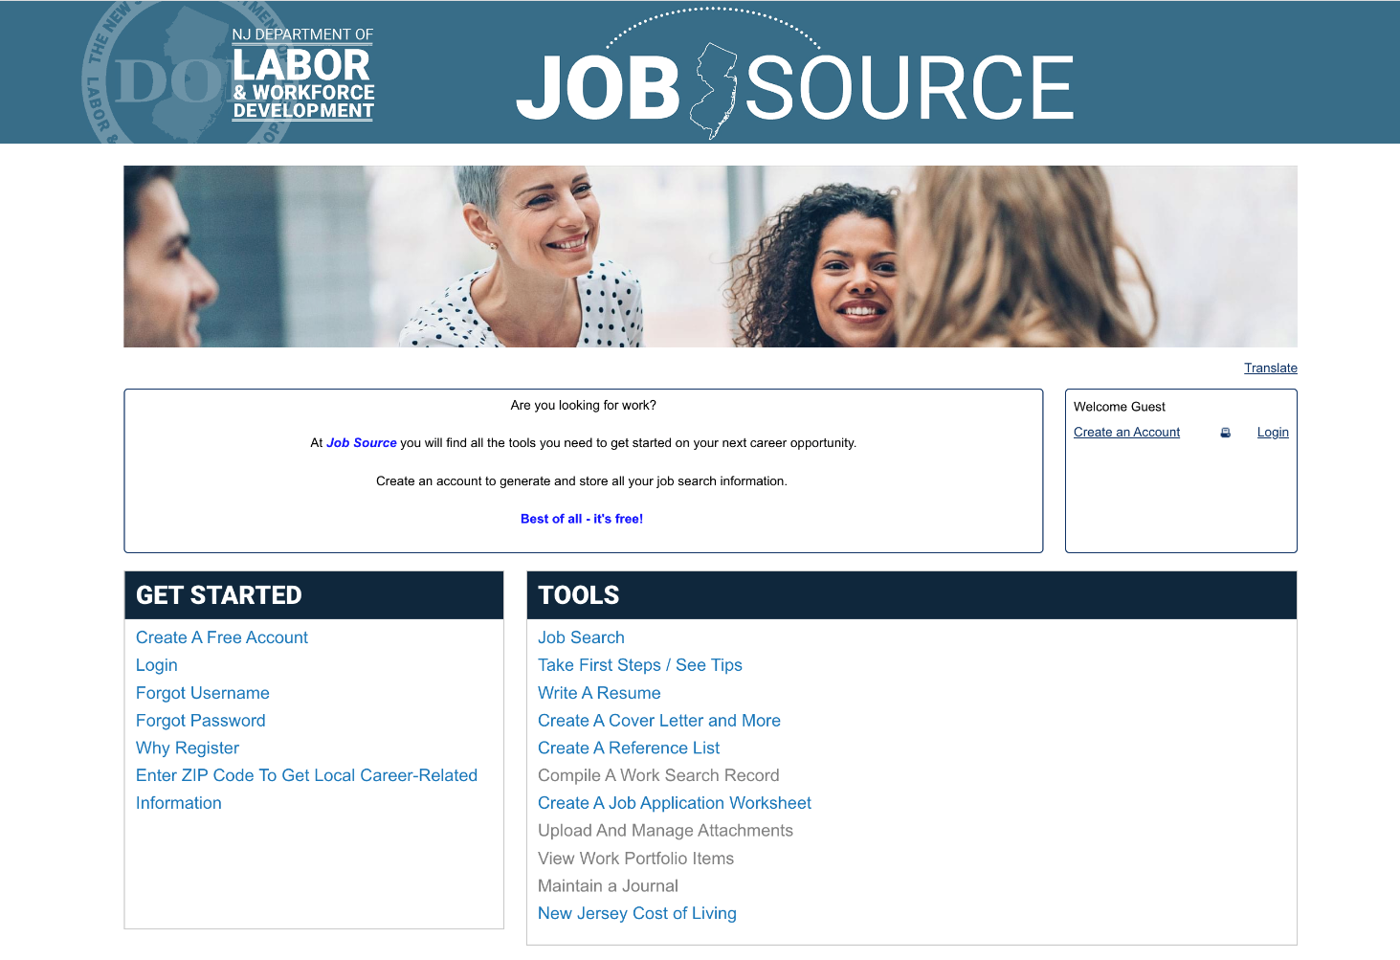
New Jersey Job Source
At Job Source you will find all you need to get started on
your next career opportunity.
Register to create an account where you can upload, create, and store all of
your job search information and documents in one convenient place.
Best of all – it’s free.
Notes:
Add your voice

Slide 12
Individualized Support
Our One Stop Career Centers offer additional WIOA employment and training services for eligible individuals. Your RESEA Career Coach can help connect you to these additional services:
▶︎ Occupational skills training to receive industry-valued credentials
▶︎ Work experiences that offer exposure to new careers and
job opportunities
▶︎ On-the-job training opportunities that blend training
and employment
  ▶︎ Supportive services that address other barriers to employment you might be facing
    For More Information:
    Please ask your Career Coach to provide additional information about WIOA programs or visit: nj.gov/labor/career-services

Slide 13
Additional Training Opportunities
▶︎ Work Search Waivers and Additional Benefits While in Training are available to qualified students to assist them with attending training that will make them more marketable.
▶︎ Work Search Waivers exempt qualified students from the requirement to actively seek work while collecting unemployment insurance.
▶︎ Additional Benefits While in Training allows qualified students to collect a maximum of 26 weeks of additional unemployment insurance benefits after exhausting their original claim.
  ▶︎ Please ask your Career Coach for additional information.

Slide 14

Veteran Services
Thank you for your service!
All Veteran Customers and Eligible Spouses receive Priority
of Service:
▶︎ On-site Veterans’ Employment Representatives (Vet Reps) offer one-on-one assistance in your job-search if you are a veteran with significant employment barriers.
▶︎ Our Vet Reps can help you craft an individual employment plan suited to your needs; and
▶︎ We provide access to other Veterans’ Services & Benefits for which you may be unfamiliar, including special services for veterans with significant employment barriers.
To Learn More, Visit:
nj.gov/military/veterans/civil-service-preference/

Slide 15
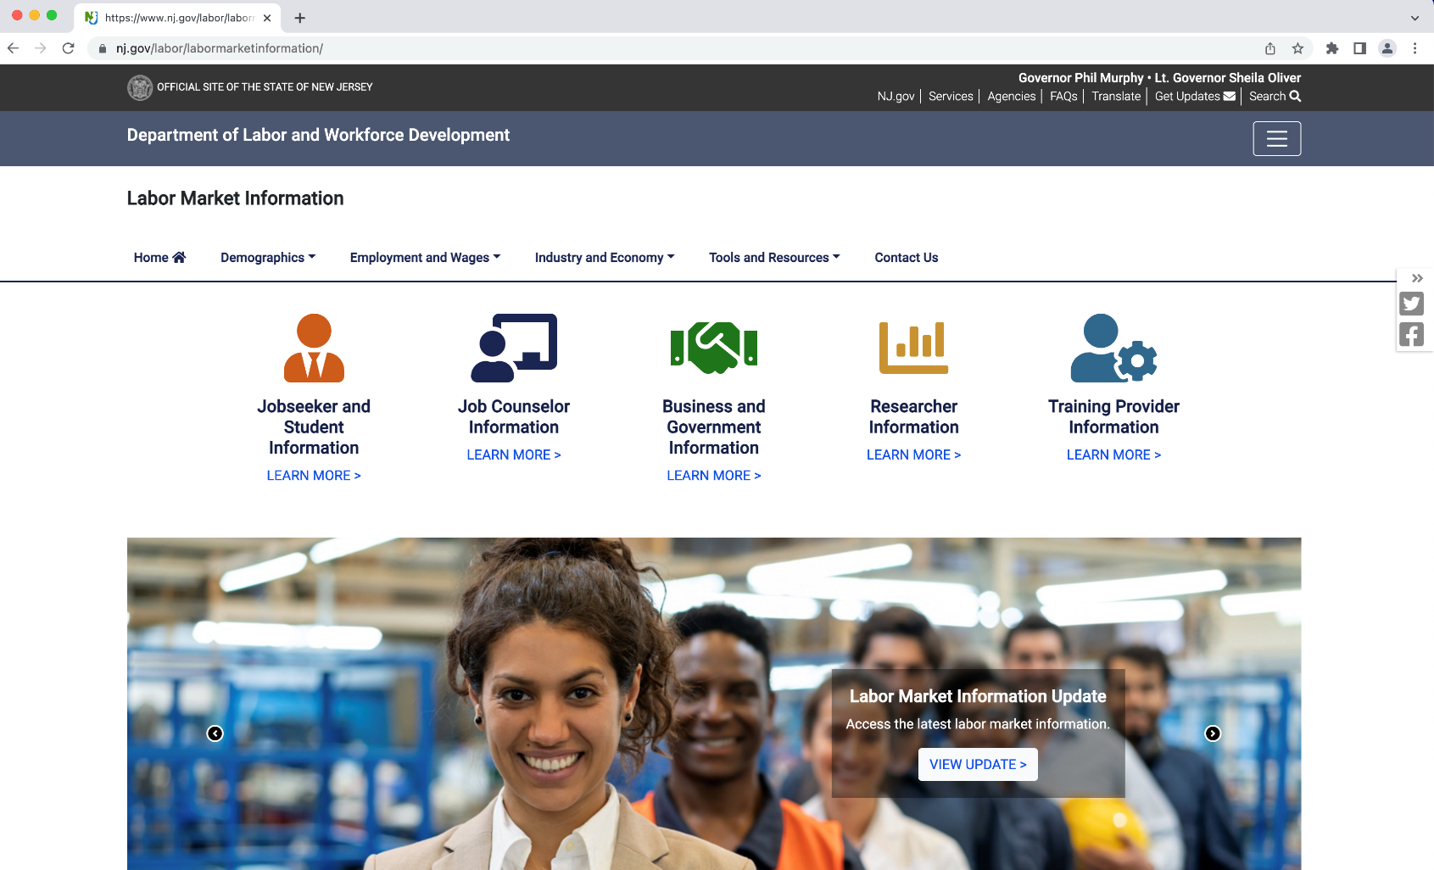
Labor Market Information (LMI)
nj.gov/labor/labormarketinformation/

Slide 16

Customers with Disabilities
What services can
DVRS provide?
Any individual with a physical, mental, cognitive, or other form of disability that is a substantial impediment to employment may qualify for services through the New Jersey Division of Vocational Rehabilitation Services (DVRS), including:
▶︎ ︎ Counseling and guidance/information and referral
▶︎ Job-search skill development
▶︎ Placement services

Slide 17

Young Adults
▶︎ ︎ Are you looking to start your future?
▶︎ Do you want to choose a good career?
▶︎ Are you unsure where to find funding?
  ▶︎ Do you need guidance to find your path?
Targeted supports and services for young people ages 16-24 are available through our local One-Stop Career Centers to low-income youth who face barriers to employment. Services strategies developed by New Jersey’s Workforce providers prepare youth for employment and/or post-secondary education through strong linkages between academic and occupational learning.

Slide 18





Connect to Community Resources

Slide 19
Migrant Seasonal Farmworker Services
z
z
Staff Assisted:
▶︎ Program Registration
▶︎ Job Referrals
▶︎ Job Development / Training
▶︎ Job Placement
▶︎ Career Guidance / Counseling
▶︎ Complaint System
▶︎ Job Order Posting
▶︎ Recruitment Assistance
Referrals to Support Services:
▶︎ Child Care Information
▶︎ Educational Resources and Training Programs
▶︎ Healthcare Service Providers
▶︎ Legal Assistance
▶︎ Emergency Needs Resources
▶︎ Pathstone

Slide 20

Businesses Incentives
▶︎ Work Opportunity Tax Credit
▶︎ On-the-Job-Training
▶︎ The Federal Bonding Program

Slide 21

Trade Impacted Workers
Trade Adjustment Assistance (TAA) dol.gov/agencies/eta/tradeact
If your job has been adversely affected by foreign competition or production and the service you provided moved overseas, you may be eligible for special Trade Adjustment Assistance (TAA) benefits including:
  ▶︎ Financial assistance for job training
  ▶︎ Extension of your Unemployment Benefits (TRA)
  ▶︎ Ask about how to file a petition to have your company “Trade Act Certified”
  Not sure if you are eligible? Ask yourself these questions:
  ▶︎ Have your hours been reduced due to international trade?
  ▶︎ Is the impact of international trade causing layoffs at your company?
  ▶︎ Have you lost your job through no fault of your own as a result of
  foreign competition?
  There are strict deadlines for some TAA benefits, including Trade Readjustment Allowance (TRA) cash benefits. For information about how to get a list of TAA certified companies ask a Career Coach about these benefits.

Slide 22

Older Worker Services
  Workforce 55+ is a federally-funded program committed to empowering economically disadvantaged seniors
  to achieve economic independence
  and control of their futures.

Slide 23

Reconnection Services
Reentry services are available for justice-involved individuals who were formally incarcerated.
If you need assistance, please contact your local One-Stop Career Center. Each One-Stop Career Center has trained staff available to assist you.

Slide 24
Office of Apprenticeship
The Registered Apprenticeship (RA) program is a training model that provides paid On-the-Job learning in conjunction with classroom instruction.
Participants are given the opportunity to learn in an environment where they experience the real-life application of skills taught while earning wages for those skills gained.
For more information, visit:
nj.gov/labor/careerservices/apprenticeship/index.shtml

Slide 25

Free Online Job Training
SkillUp New Jersey offers a full suite of on-line learning classes.
Wide variety of
courses available that can help you:
▶︎ Obtain industry-recognized certificates
▶︎ Earn college credit
▶︎ Develop work readiness skills
▶︎ Enhance your resume
https://nj.metrixlearning.com

Slide 26
O*Net Online
▶︎ Find job descriptions that you can use to identify keywords and develop your resume.
▶︎ Find jobs that match your interests, skills,
and experience.
▶︎ Learn how to translate your job to other careers.
▶︎ Explore careers with potential growth.
▶︎ Obtain salary information/ranges.
Learn about skills that are in demand
onetonline.org/

Slide 27

Beware of Job Scams
▶︎ Be cautious when applying to jobs where the email address ends in things like Gmail, Yahoo or Hotmail. Most legitimate employers have a company email address.
▶︎ Learn the difference between an independent contractor and
an employee. For example, independent contractors are not “employees” of the company and as such, aren’t eligible for unemployment benefits.
▶︎ Legitimate employers don’t ask you to pay for training or to buy something from them first as a condition of employment.
If you come across a suspected employment scam, please email your Career Coach with details so it can be investigated.

Slide 28

RESEA is here to help…
  You will have the most success in obtaining a
  good-paying job that aligns with your interests if
  you start looking for work early. We can help guide you and help you stay on task!
  So why wait?

